Slide 1
Fixation and Event Visualization
By Brian Drennan, Eric Lawson, John Ta, Suraj Nair, Shraddha Nagargoje

Slide 2
Goal
To provide a high level overview of the data, and provide context.
To show how the eye tracking data relates to the tasks that the person was trying to complete.
Premises
How the data is gathered influences how we should interpret the data.
People would repeat some behavior for each question they answer. Answering one question might be a meaningful chunk of data to analyze.
Questions
What is the context in which this data was gathered?
How does where a person looks relate to their process for solving their task?
What kind of further analysis is worth pursuing?
How should we handle the data in further analysis?
Notes:
Eric

Slide 3
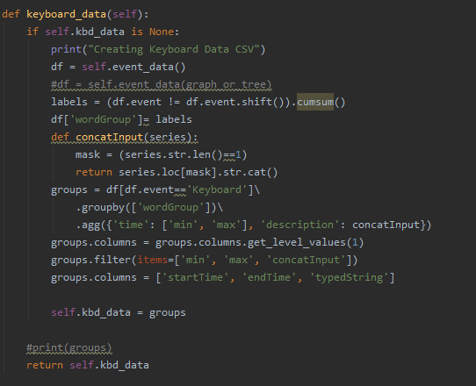
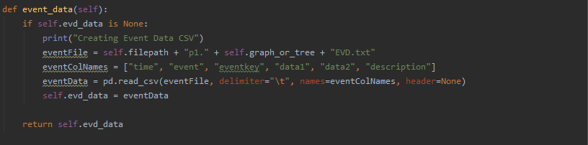
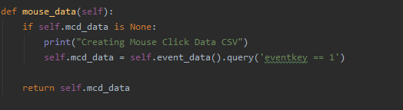
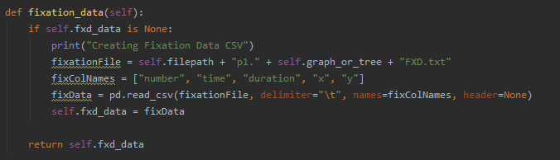
Data Processing
Language: Python Libraries: Pandas and Plotly
Fixation Data
Event Data
Mouse Click Data
Keyboard Data
Notes:
Shraddha
Pandas Dataframe:
Specific datasource are selected (graph, tree)
Fixation and Event Data
Fixation Data
Total Fixation using the Gaussian Filter Algorithm
Fixation Paths in intervals of 10 seconds
Event Data:
Mouse click Data in intervals of 10 seconds
Keyboard Data grouped up into events broken by continuous mouse events.
wedandadsdcscd

Slide 4
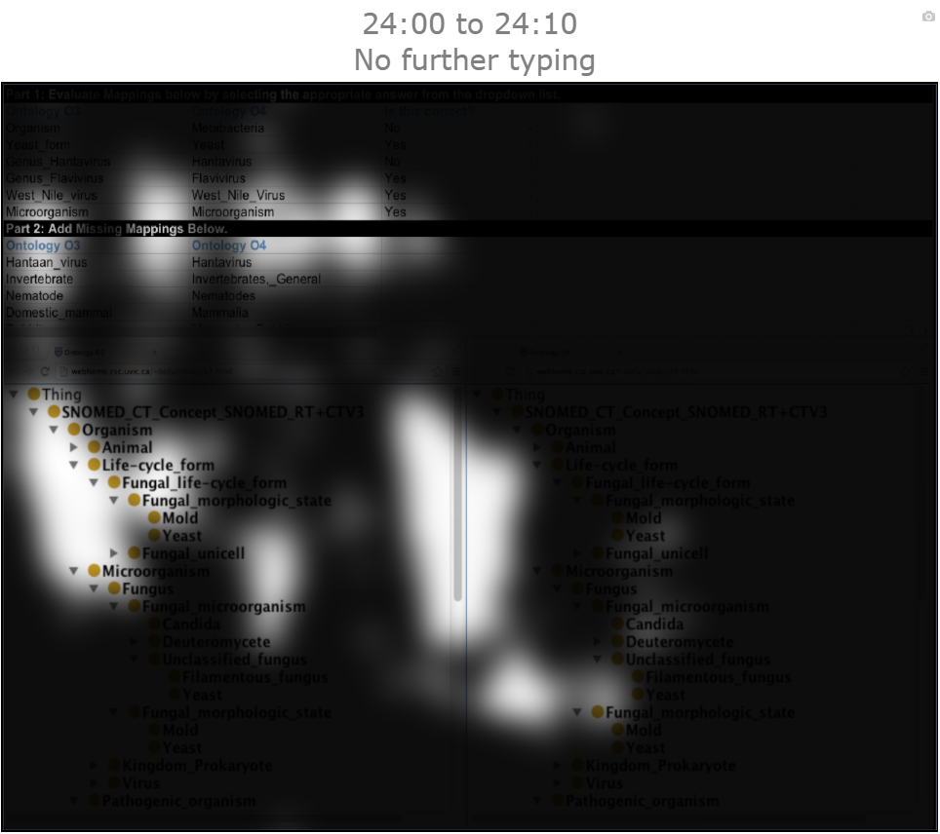
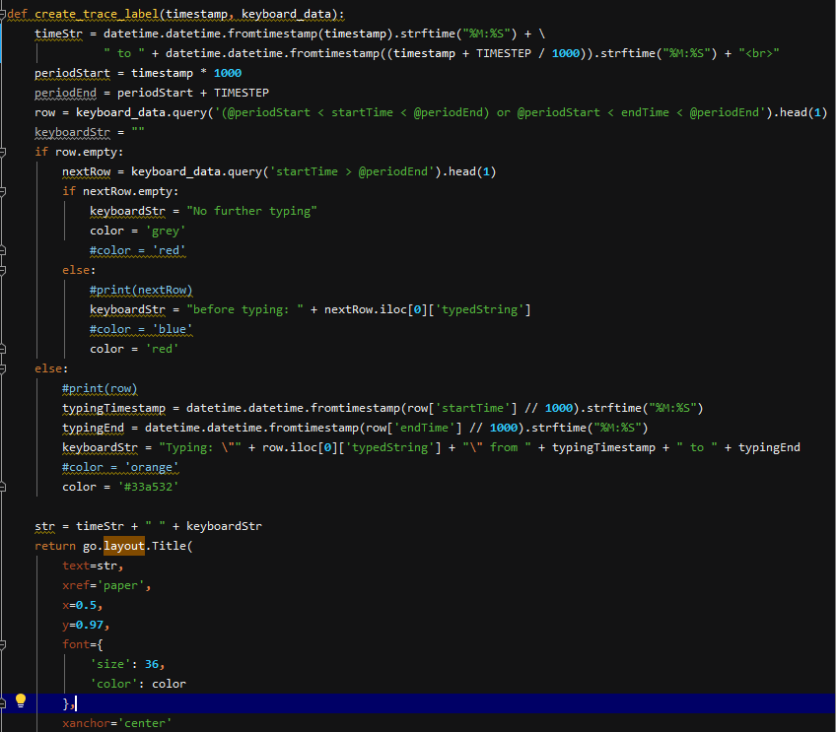
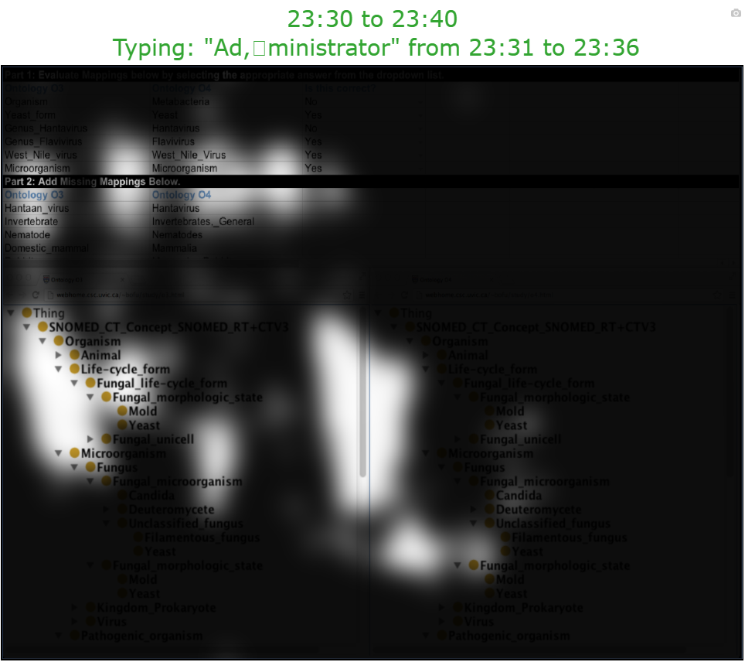
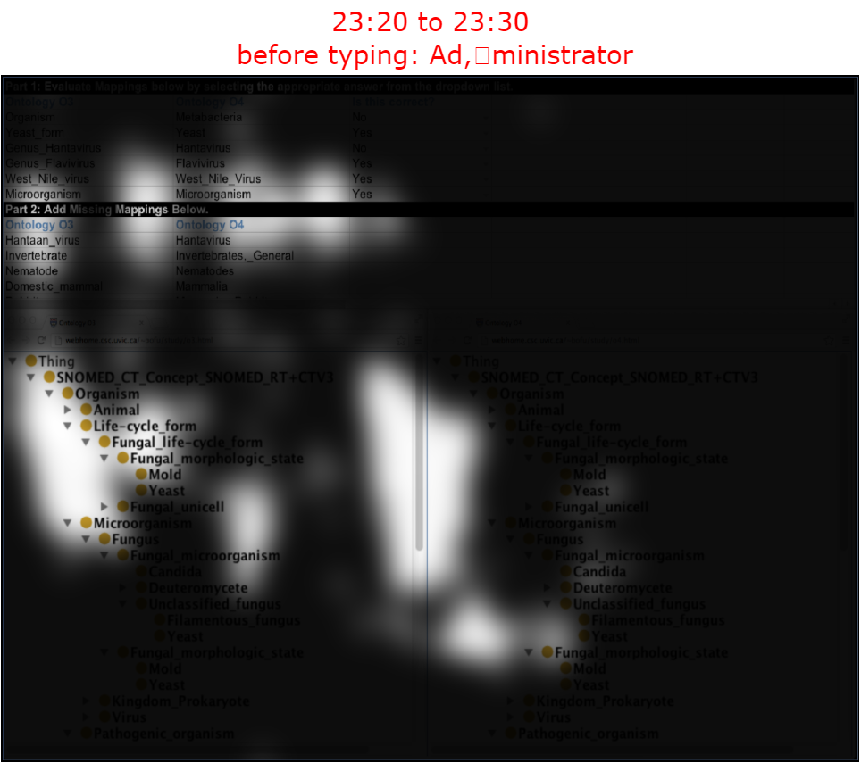
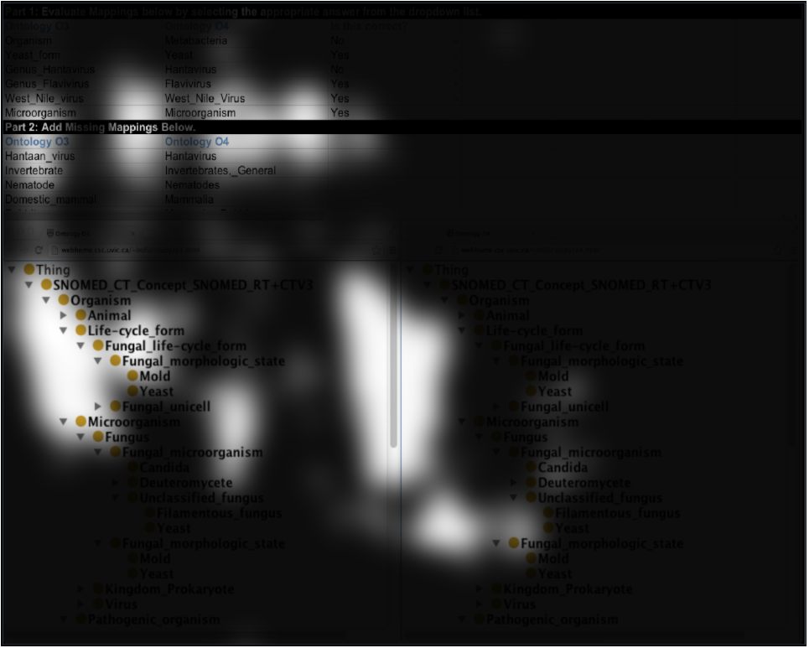
Keyboard Events
Notes:
Shraddha
Time slice
For each time slice of 10 seconds we show the participants keyboard events
Why?
Questions Answered?

Slide 5
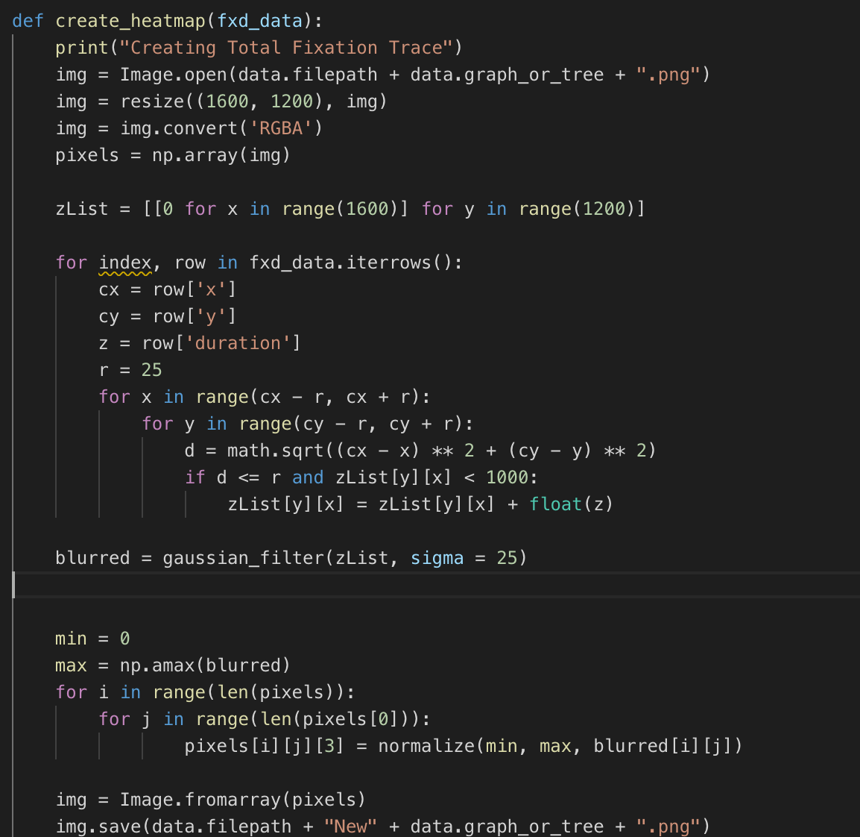
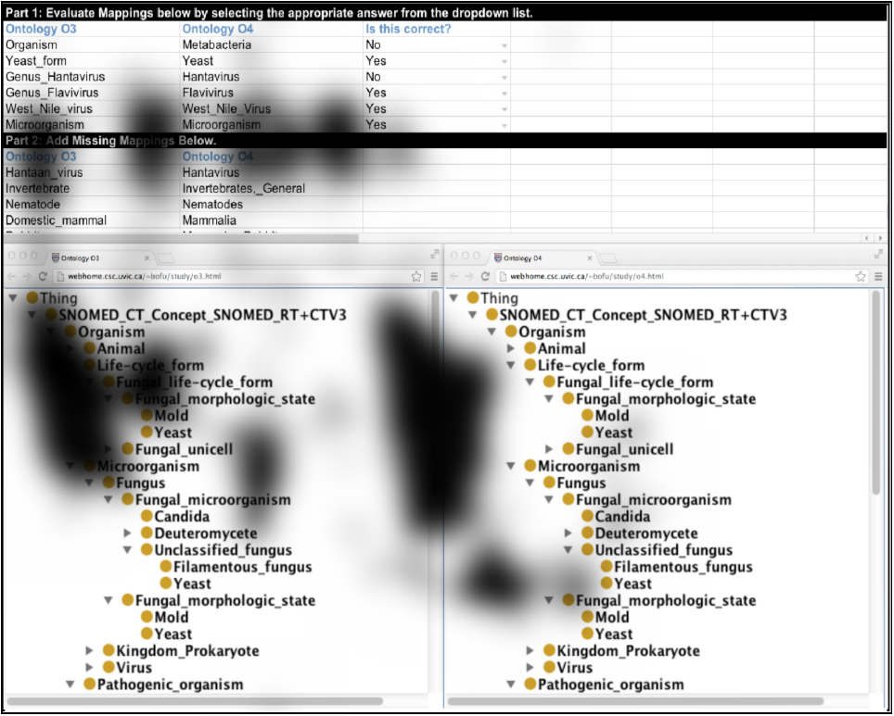
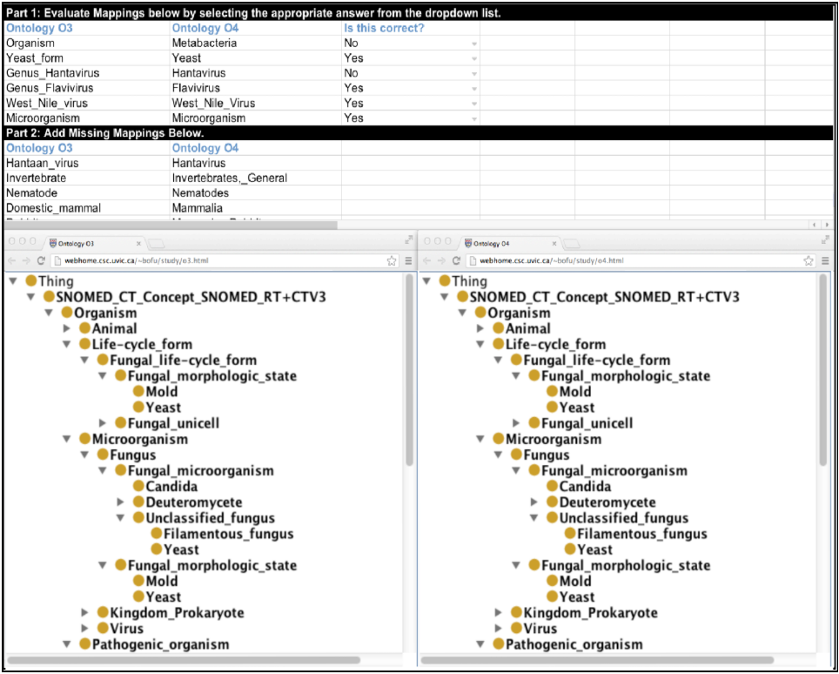
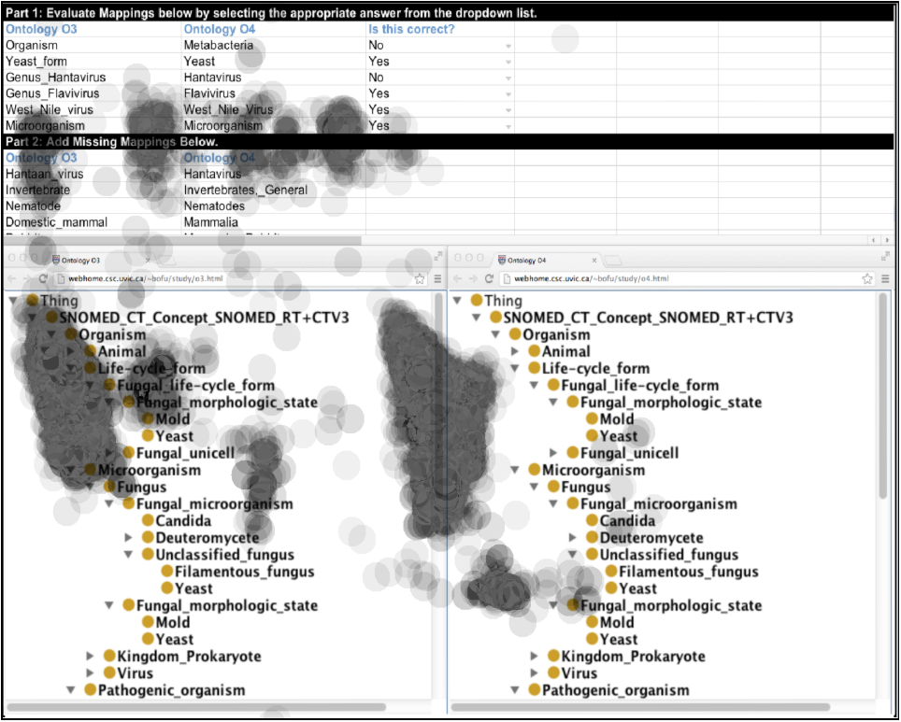
Total Fixation Heatmap
Background image as 1600x1200 screen
Darken fixation areas
Apply Gaussian Filter
Reverse with minimum 10% Opacity
Notes:
Brian
Why?
Provides meaningful representation of fixation data. Having this overlay provides the viewer with an easy way to see where the participant focused during the experiment.
How?
Using the fixation duration times, we were able to to plot the duration time in relation to the associated X and Y coordinates. By using this association, each pixel on the 1600 X 1200 screen has an associated z value. This z value was used to determine the opacity/visibility of the pixel. Values with higher duration times decreased visibility. Areas of low duration, led to the contrary.
The implementation of a Gaussian Filter allowed for a smooth transition between pixels opacities.
Areas of fixation were not able to be seen, so we reversed it.
Apply this visualization directly to the original image to create a more realistic view.
Questions Answered?
Shows the areas of high interest during the experiment where user spent most time focusing.

Slide 6
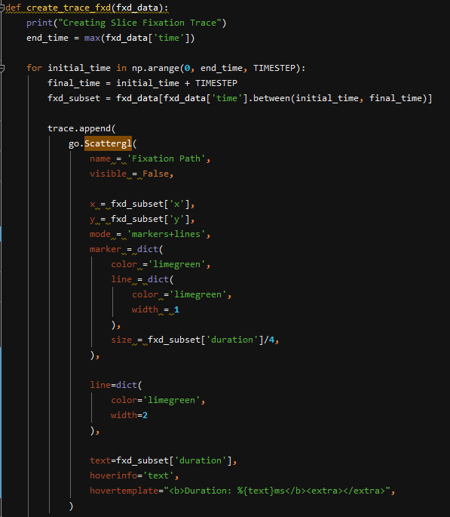
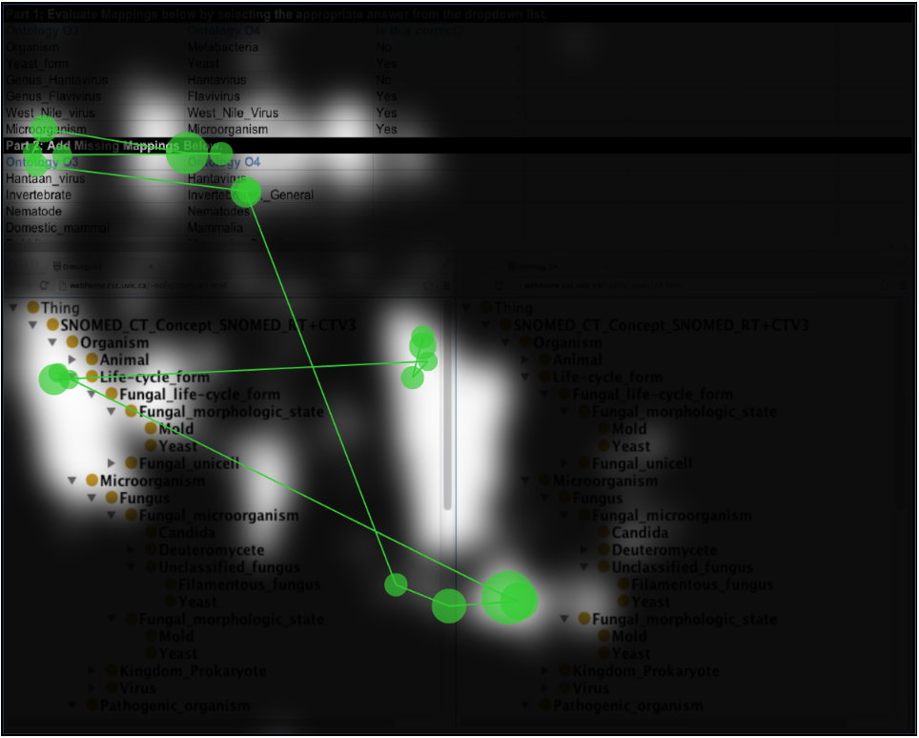
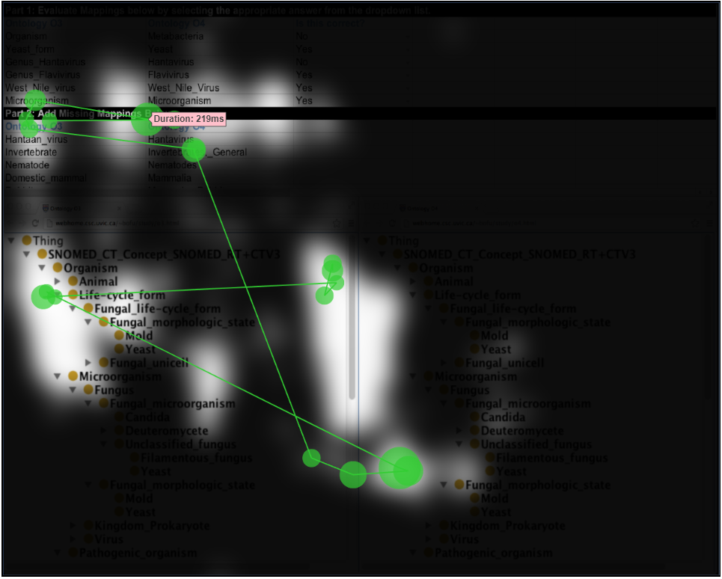
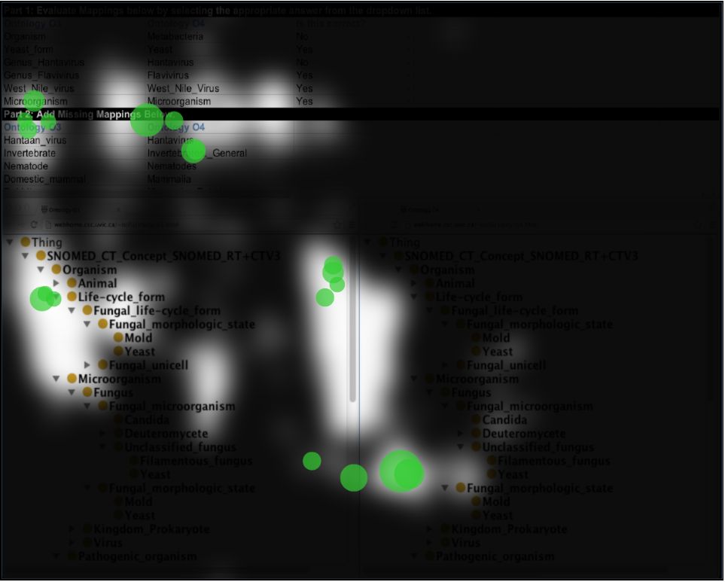
Fixation Path
Markers
Lines
Duration
Notes:
Brian
Time slice using Scatterplot
For each time slice of 10 seconds we show the participants fixation movement from one area to another and the duration of fixation is represented by the size of the circle.
Why?
By providing the fixation path we were able to create a visual representation of how the participant moved across the screen based on their gaze data.
Questions Answered?
Apart from the areas of high interest in regard to fixation. What was the pattern of focus for the participant.
The pattern of focus may indicate areas on the screen which provided difficulty for the participant if they continually shifted focus back and forth.

Slide 7
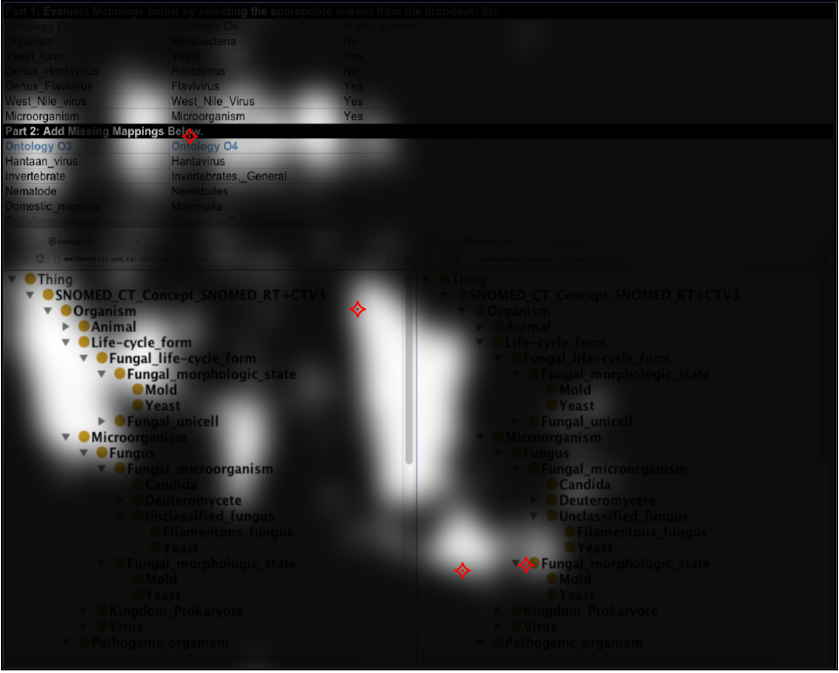
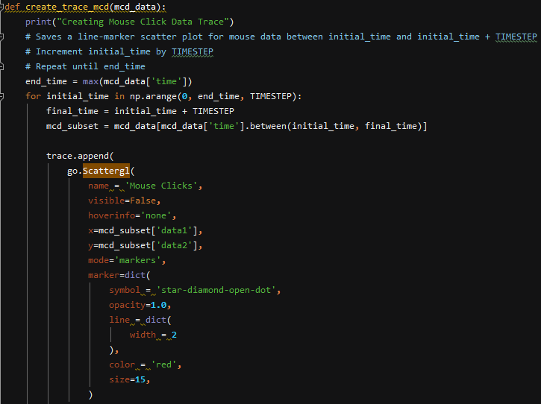
Mouse Clicks
Markers
Notes:
Brian
Time slice using Scatterplot
For each time slice of 10 seconds we show the participants mouse click event locations
Why?
Questions Answered?

Slide 8
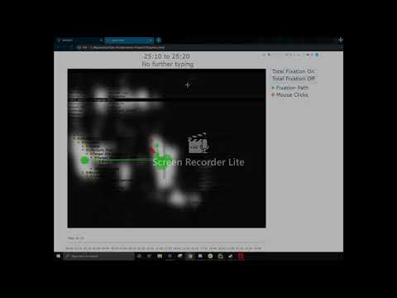
Time Slider and Time Intervals
Time Slider
Increments through time frames in intervals of 10 seconds
Time Interval
Keyboard Event
Fixation Path Trace
Mouse Click Trace
Notes:
Suraj Nair
Heatmap
Can be toggled on or off
Time Slider
Each tick is a 10 second time interval
Each Interval has
Keyboard Event
Color codes depending on if a word is coming up, is currently being typed, or there are no more words
Fixation Path Trace
Lines connecting fixations in sequence
Markers dependent on fixation duration for size
Has a hover feature to display fixation duration
Can be toggled on or off
Mouse Click Trace
Markers to show location of mouse click
Can be toggled on or off
Maybe briefly discuss the use of the visualization, now that we can see all visualizations together?

Slide 9
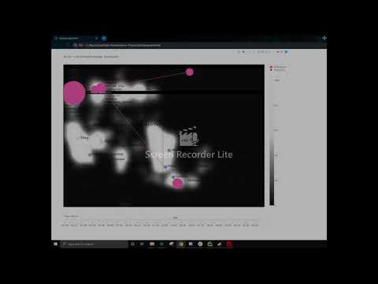
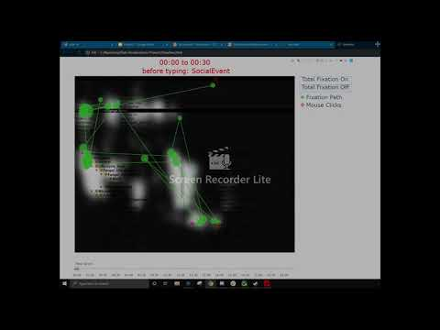
Challenges
Background Image is just a representation
Performance Issues
Gaze data for heatmap
Gaussian heat map trace
Time interval balance
Versatility of Plotly was not used to fullest extent due to lack of experience
Notes:
John

Slide 10
Contributions
Brian Drennan: pitched and created heatmap of the fixation
Eric Lawson: created processing data; created the backbone code of the visualization; created keyboard related visualizations; suggested Gaussian Filter algorithm for the heatmap; found solutions to most issues
Shraddha Nagargoje: analyzed data to use for the visualization; helped in creating buttons to switch on/off views such as the heatmap
Suraj Nair: analyzed data to use for the visualization; gave valuable criticism to the overall visualization
John Ta: expanded on the backbone code of the visualization; tied in all code to one visualization
Notes:
John

Slide 11
Answers to our Questions
What is the context in which this data was gathered? How does where a person looks relate to their process for solving their task?
By relating where a user fixated their gaze with the user interface we can understand what they were fixated on.
Additionally we can understand how those locations relate to the task by seeing where they click and what they are typing.
By looking ahead to the next text entry we can add context even when the person is not typing.
What kind of further analysis is worth pursuing? How should we handle the data in further analysis?
Because the data is separated by part 1 and part 2 of their task, it is likely that further analysis should separate these data points because they represent answering different kinds of questions.
Because the data represents answering many questions we could break down the data into chunks that represent answering a single question, which would allow us to better understand their process for answering questions and determine patterns and variations in how they solve problems.
Some people might not do part 1 and part 2 separately, so further analysis of other people could confirm or disconfirm that.
Notes:
Eric

